Slide 1


Data-Driven Audience
Engagement Optimization-Social Buzz
LOGAMBAL J

Slide 2


Today's agenda
Project Recap
Problem
The Analytics team
Process
Insights
Summary

Slide 3

Objective: Optimize audience engagement through data-driven analysis.
Key Components: Content analysis, audience engagement metrics, data insights, optimization strategies.
Deliverables: Analysis reports, recommendation strategies, implementation plan, performance tracking.
Goal: Enhance audience engagement and improve content relevance.
Outcome: Drive project success through targeted strategies and actionable insights.
Project Recap

Slide 4


Problem
In today's digital world flooded with content, creators struggle to attract and retain audience attention. Understanding audience preferences is key to optimizing content strategy.
This project aims to leverage data insights to analyze content performance, identify audience preferences, and enhance audience engagement effectively.

Slide 5



The Analytics team
Andrew Fleming (Chief Technical Architect),
Marcus Rompton (Senior Principle),
Logambal ( Myself )

Slide 6
Data Understanding
1
Data Cleaning
2
Data Modelling
3
Process
Data Analysis
4
Driving Insights
5

Slide 7
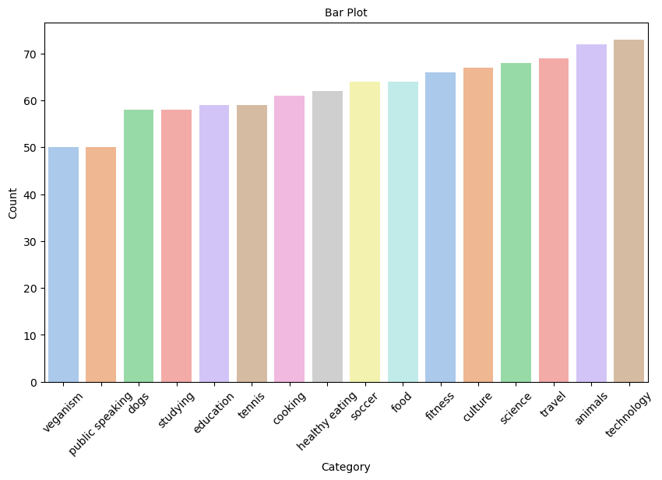
CONTENT ANALYSIS
Inference:
1. Based on the above bar chart, we can conclude that the technology category has the highest count overall, accounting for 7.3%, while veganism has the lowest count at 5%.
Recommendations:
Diversify Content: Expand beyond technology to cater to diverse interests.
Engage Niche Audiences : Focus on specialized content for the veganism niche.
Explore Emerging Trends: Stay updated and tap into rising interests.
Optimize Content: Analyze and tailor content for maximum engagement.

Slide 8
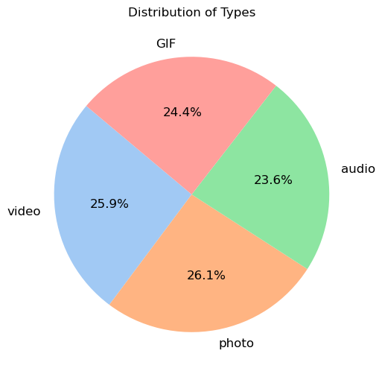
Inference
1. Based on the above pie chart, we conclude that the photo content type has the highest count at 26.1%, while the audio type has the least count at 23.6%.
Recommendations:
Enhance Audio Content: Given its lower count, focus on improving the quality and appeal of audio content to attract more engagement.
Leverage Visual Content: Capitalize on the popularity of photo content by creating visually compelling and shareable material.
Diversify Content Formats: Explore other content types such as video or interactive content to offer variety and cater to diverse audience preferences.
Analyze Audience Preferences: Continuously monitor audience feedback and engagement metrics to refine content strategies and prioritize high-performing content types.

Slide 9

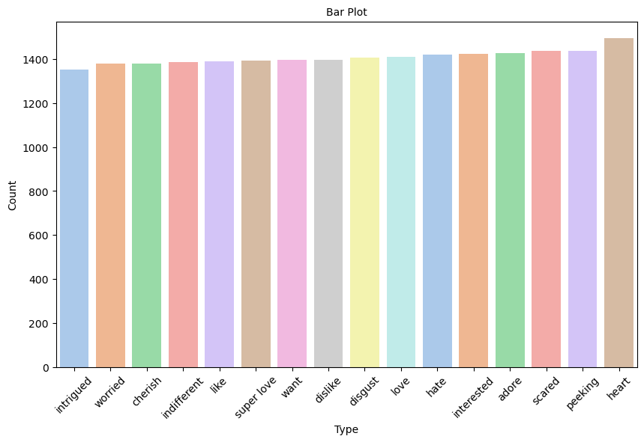

REACTION ANALYSIS
Inference
Based on the above bar chart, we can conclude that the Heart reaction type has the highest count overall, accounting for 6.6%, while the Intrigued reaction type has the lowest count at 6%.
Recommendations:
Encourage Engagement: Since the "heart" reaction type is popular, encourage users to express their appreciation by providing engaging and valuable content.
Improve Visibility: To boost engagement with lesser-used reaction types like "intrigued", highlight their availability and encourage users to explore and utilize them.
Analyze User Feedback: Continuously monitor user feedback to understand preferences and tailor content strategies to resonate with the audience.
Experiment with Content: Experiment with different types of content and gauge audience reactions to identify what resonates best and optimize engagement.

Slide 10
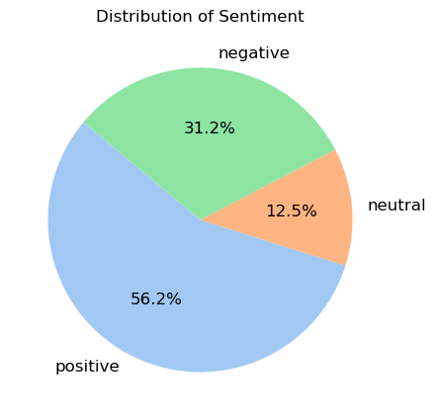
REACTION TYPE ANLYSIS
Inference
1. Based on the above pie chart, we can conclude that positive sentiment accounts for 56.2%, while neutral sentiment is notably lower at 12.5%.
Recommendations:
1. Leverage Positive Sentiment: Given the dominance of positive sentiment, capitalize on this by crafting content that elicits positive emotions and responses from the audience.
2. Address Neutral Sentiment: Although neutral sentiment is lower, it's essential to understand the reasons behind it. Consider analyzing feedback and engaging with the audience to address any concerns or areas for improvement.
3. Content Personalization: Tailor content to resonate with the predominant positive sentiment while ensuring inclusivity and relevance for those expressing neutral sentiments.
4. Monitor Sentiment Trends: Continuously monitor sentiment trends over time to adapt content strategies and maintain alignment with audience preferences and attitudes.

Slide 11
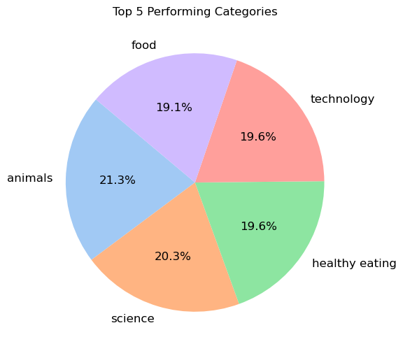
TOP 5 CATEGORIES
The top 5 categories are as follows:
1. Animals - 21.3%
2. Science - 20.3%
3. Healthy Eating - 19.6%
4. Technology - 19.6%
5. Food - 19.1%
Recommendations:
1. Leverage Popular Categories: Focus on producing high-quality content in the top-performing categories to maintain engagement and interest.
2. Explore Synergies: Look for opportunities to intersect popular categories. For instance, combining science with healthy eating could yield informative content on nutrition or wellness.
3. Audience Interaction: Encourage audience interaction and feedback to better understand their preferences within these top categories.
4. Diversification: While focusing on popular categories is essential, consider diversifying content to maintain a balanced and engaging content strategy. Explore emerging trends and niche interests to expand audience reach and engagement.

Slide 12


Summary

Slide 13
Overall Inference:
Top Performing Categories: The analysis revealed that the top-performing categories are animals, science, healthy eating, technology, and food. These categories garner the highest engagement and interest among the audience.
Sentiment Analysis: Positive sentiment dominates, indicating a favorable response to the content. However, there is a notable presence of neutral sentiment, suggesting areas for potential improvement or further exploration.
Content Types: The analysis suggests that photo content is the most prevalent, followed by audio content. However, there may be opportunities to enhance audio content to increase its engagement.
Reaction Types: The "heart" reaction type is the most frequently used, indicating a positive response from the audience. Other reaction types such as "intrigued" are less utilized, presenting opportunities to encourage diversity in audience engagement.

Slide 14
Overall Recommendations:
Content Optimization: Continue to produce high-quality content within the top-performing categories to maintain engagement levels. Explore diverse topics within these categories to cater to various interests within the audience.
Engagement Strategies: Encourage audience interaction and feedback to gain insights into their preferences and interests. Utilize polls, surveys, and Q&A sessions to foster community engagement.
Sentiment Analysis: Regularly monitor sentiment trends to gauge audience satisfaction and identify areas for improvement. Address any concerns or issues raised by neutral sentiment through proactive communication and action.
Content Diversity: While focusing on popular categories, maintain a balance by diversifying content types and formats. Explore emerging trends and niche interests to expand audience reach and engagement.
Reaction Diversity: Promote the use of diverse reaction types to encourage varied forms of audience engagement. Educate the audience on the availability and significance of different reaction options to foster inclusivity and diversity in engagement.

Slide 15
Thank you!
ANY QUESTIONS?

